Slide 1

Disaster Tweet Classification
Using bert – bidirectional encoder representations from transfromers

Slide 2
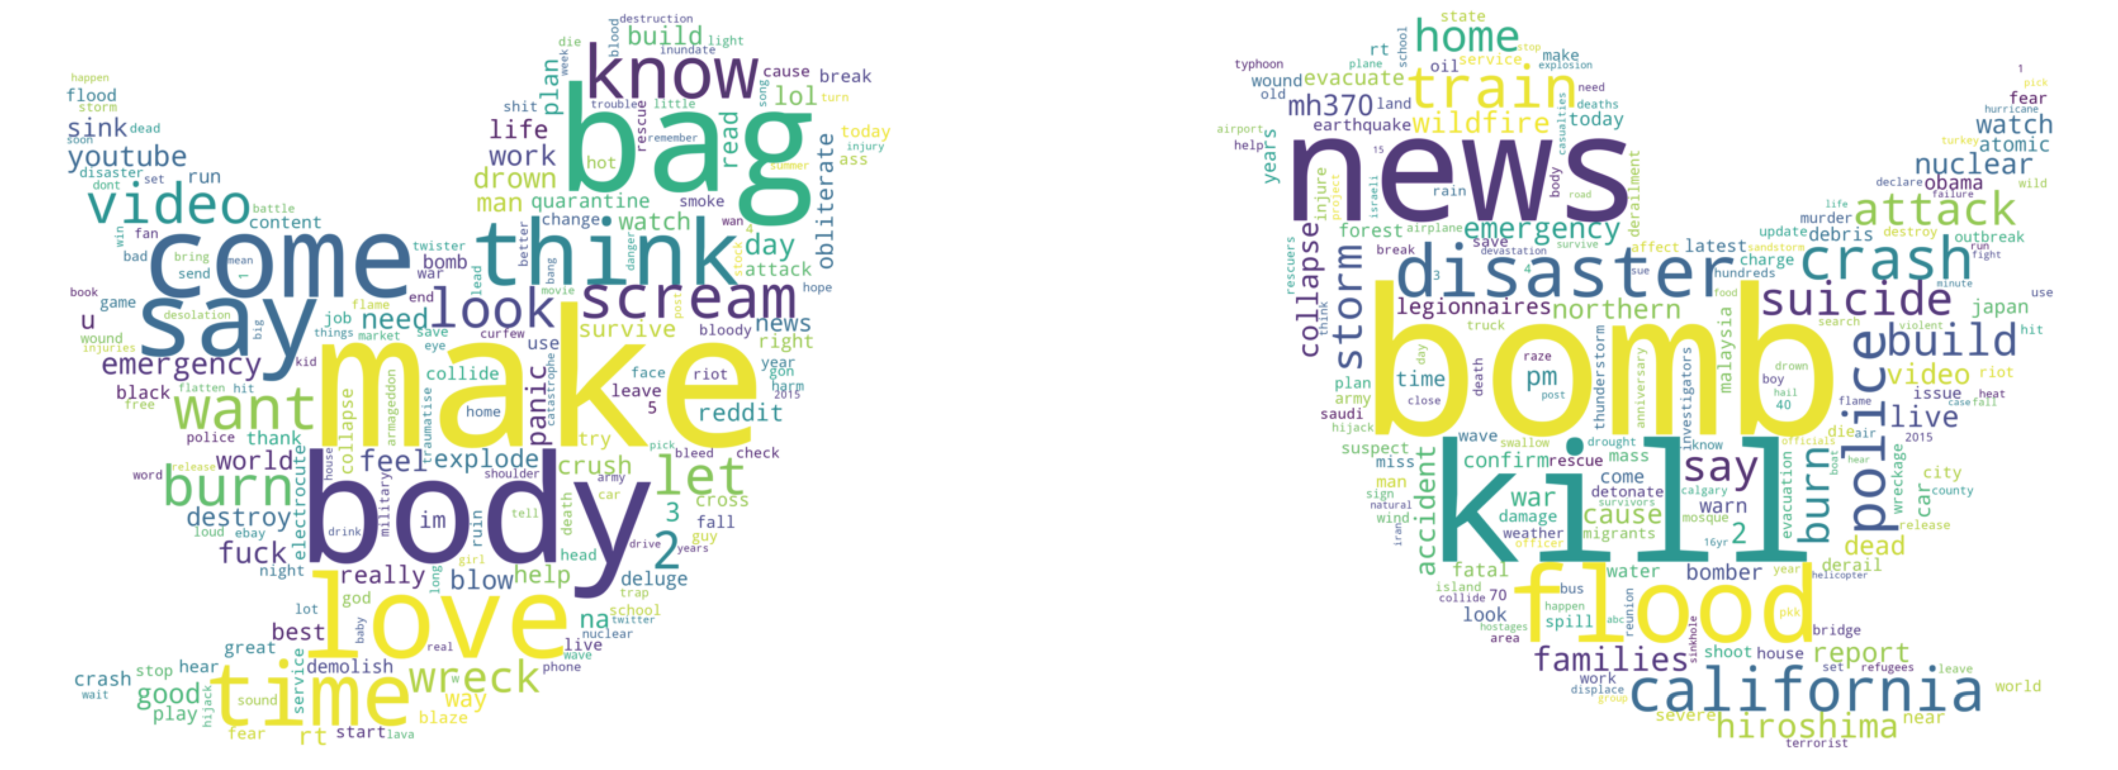
Introduction
The disaster tweet classification project has real world significance of accurately classify the tweets about the occurrence of disaster in a specific place with high accuracy and efficiency so that the lives of people can be saved in several places.
The machine learning model that has been used to solve the tasks of classifying the tweet regarding whether a disaster will take place in that specific area or not is BERT(Bidrectional Representational Encoders from Transformers).

Slide 3
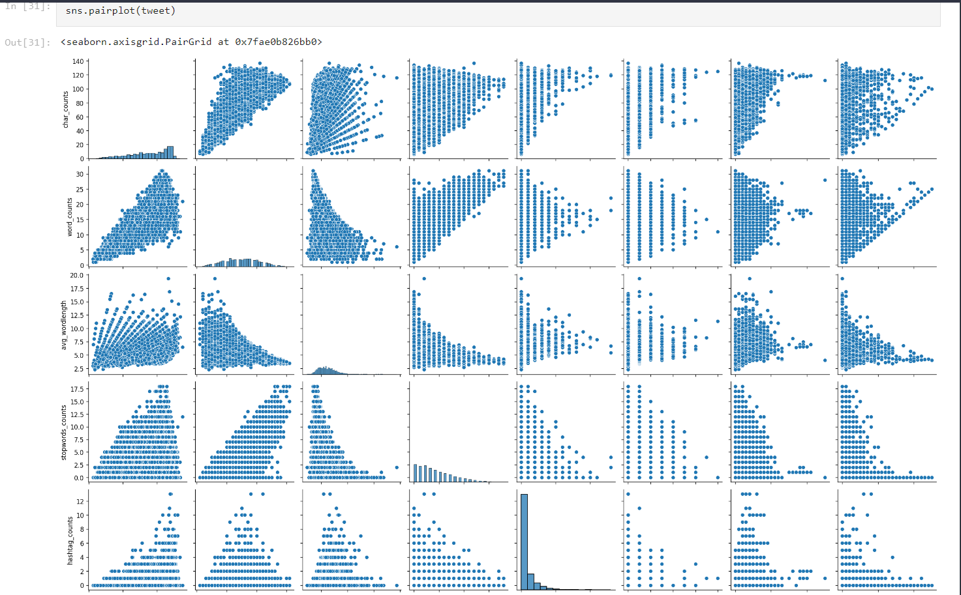
EXPLORATORY DATA ANALYSIS
A pair plot of all the attributes present in the dataset has been plotted using the Seaborn library.

Slide 4
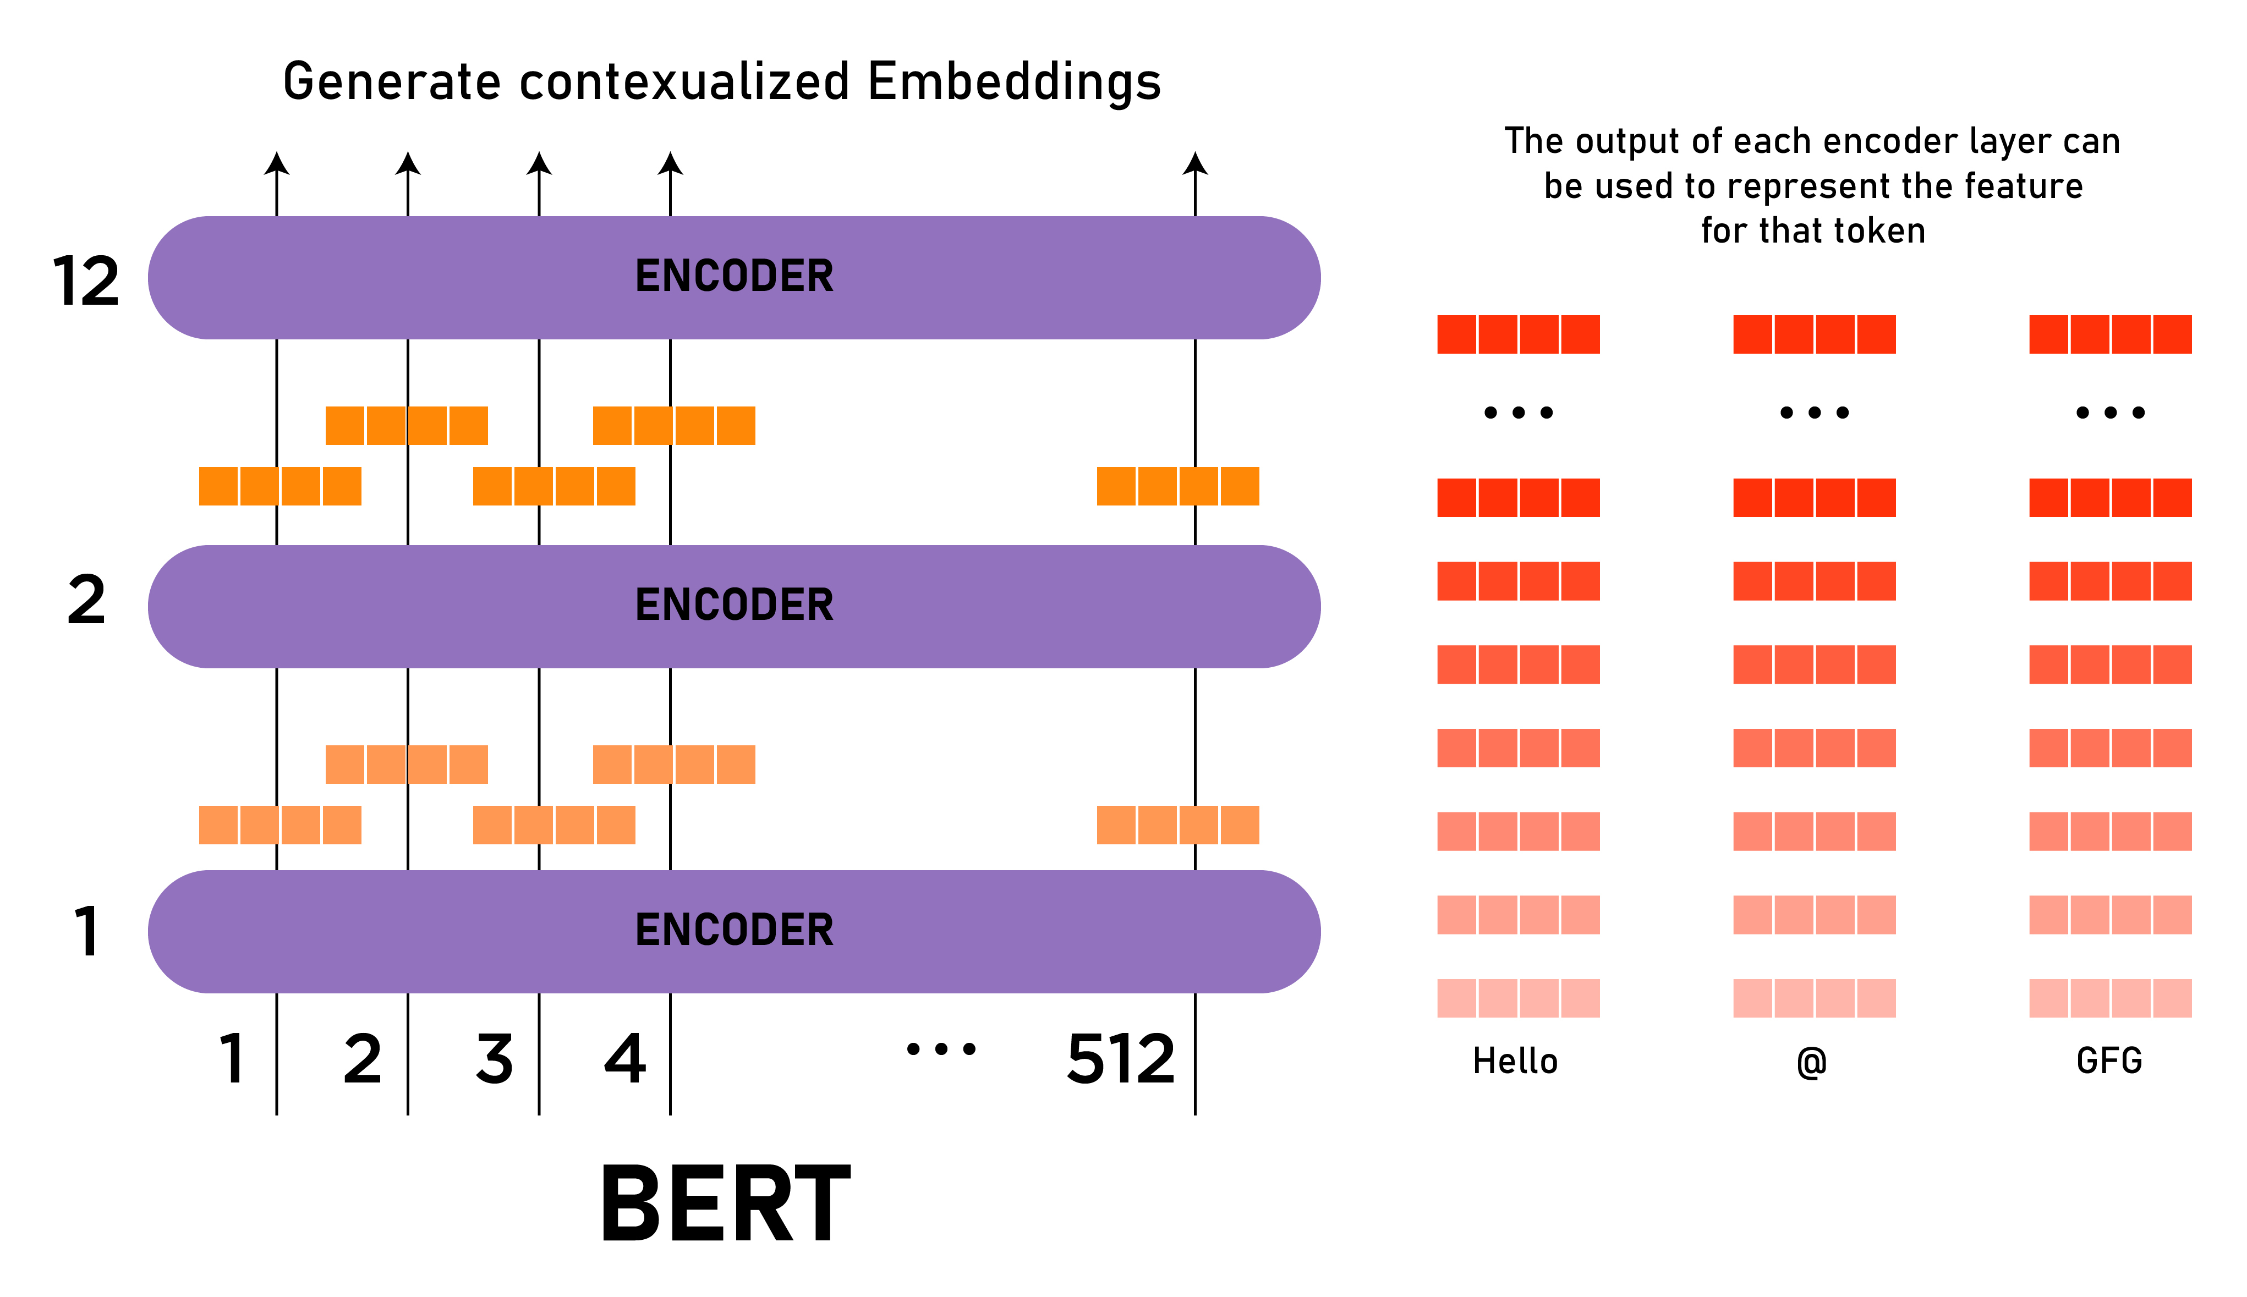
INFORMATION ABOUT BERT
BERT is basically an Encoder stack of transformer architecture. A transformer architecture is an encoder-decoder network that uses self-attention on the encoder side and attention on the decoder side. BERTBASE has 12 layers in the Encoder stack while BERTLARGE has 24 layers in the Encoder stack. These are more than the Transformer architecture described in the original paper (6 encoder layers). BERT architectures (BASE and LARGE) also have larger feedforward-networks (768 and 1024 hidden units respectively), and more attention heads (12 and 16 respectively) than the Transformer architecture suggested in the original paper. It contains 512 hidden units and 8 attention heads. BERTBASE contains 110M parameters while BERTLARGE has 340M parameters.

Slide 5
Takeaways From the Project
The project was completed in two days with the usage of Agile methodology and the problems encountered while developing the project were resolved using the documentation and other resources such as Videos and consulting with the industry experts.
The project was developed using the Python programming language, Seaborn, Matplotlib, Scikit Learn, Keras ,TensorFlow and Ktrain libraries which assisted me in creating a solution which could assist in classification of disaster tweets.

